Slide 1
Group Event E-ticketing
Start now!

Slide 2
Eticket is a ticket booking application who built with java GUI program and database SQL Server
Background

Slide 3
Eticket
Design
Source Code
Design Forms In Eticket
Source Code And Database

Slide 4
Logins
Register
Welcome
GET TICKET
PAYMENT
MENU
APPLICATION FLOW

Slide 5
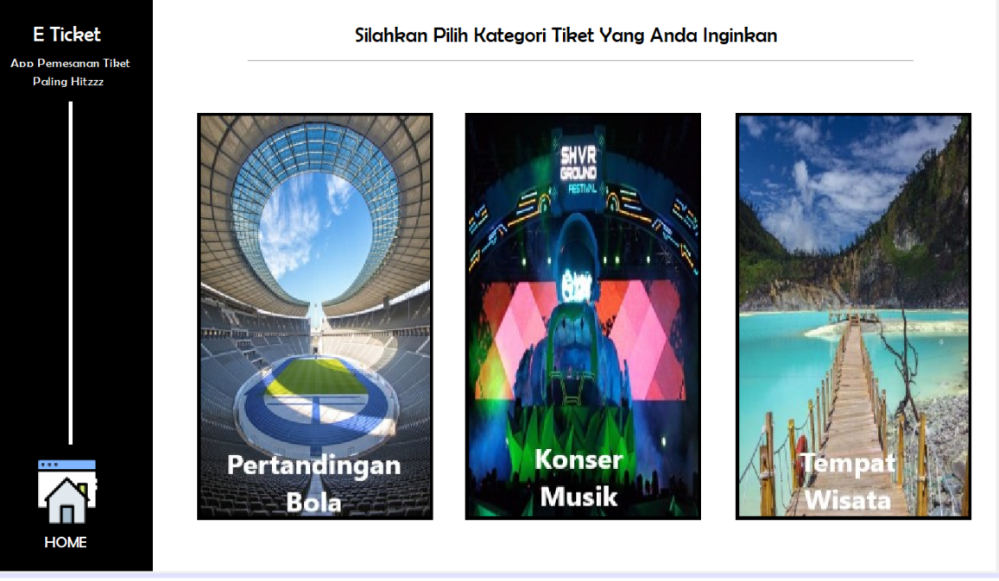
MENU
THERE ARE 3 EVENTS
1.
PERTANDINGAN BOLA
2.
KONSER MUSIK
3.
TEMPAT WISATA

Slide 6
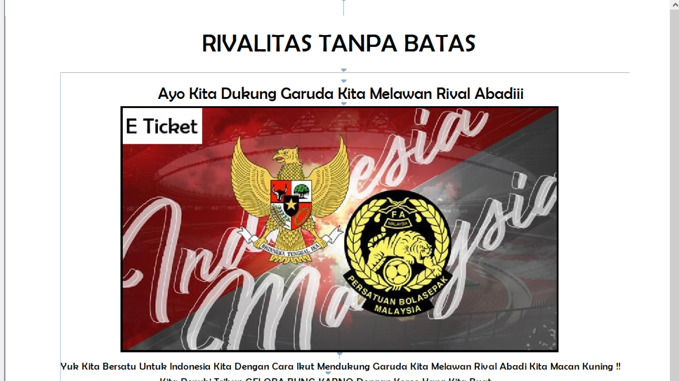
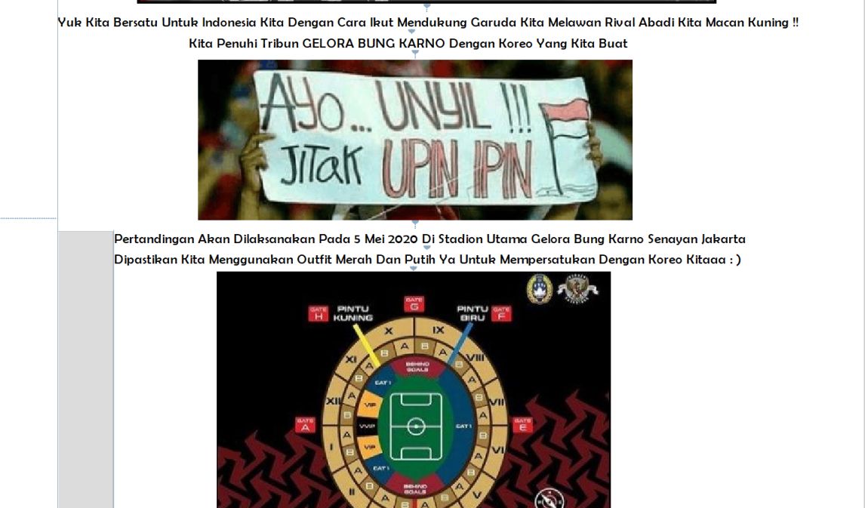
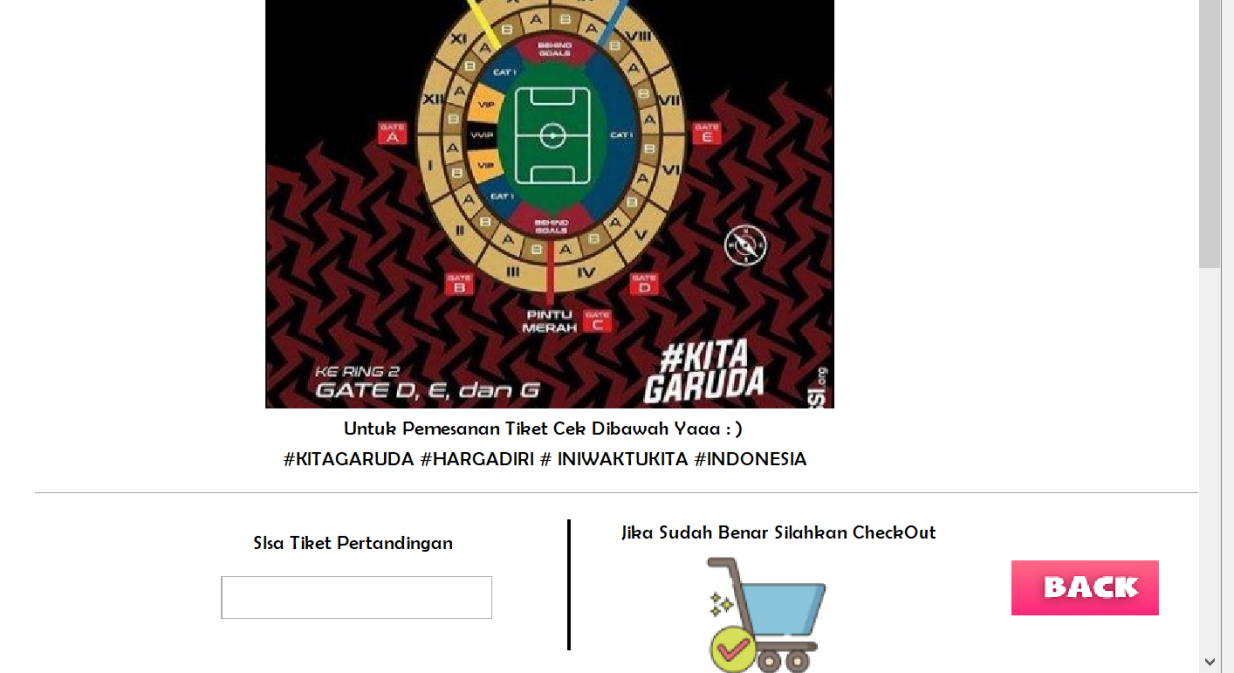
Sepak Bola
Details soccer tournament

Slide 7
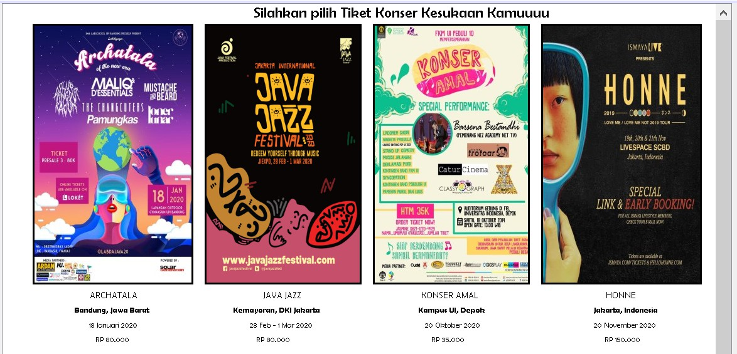
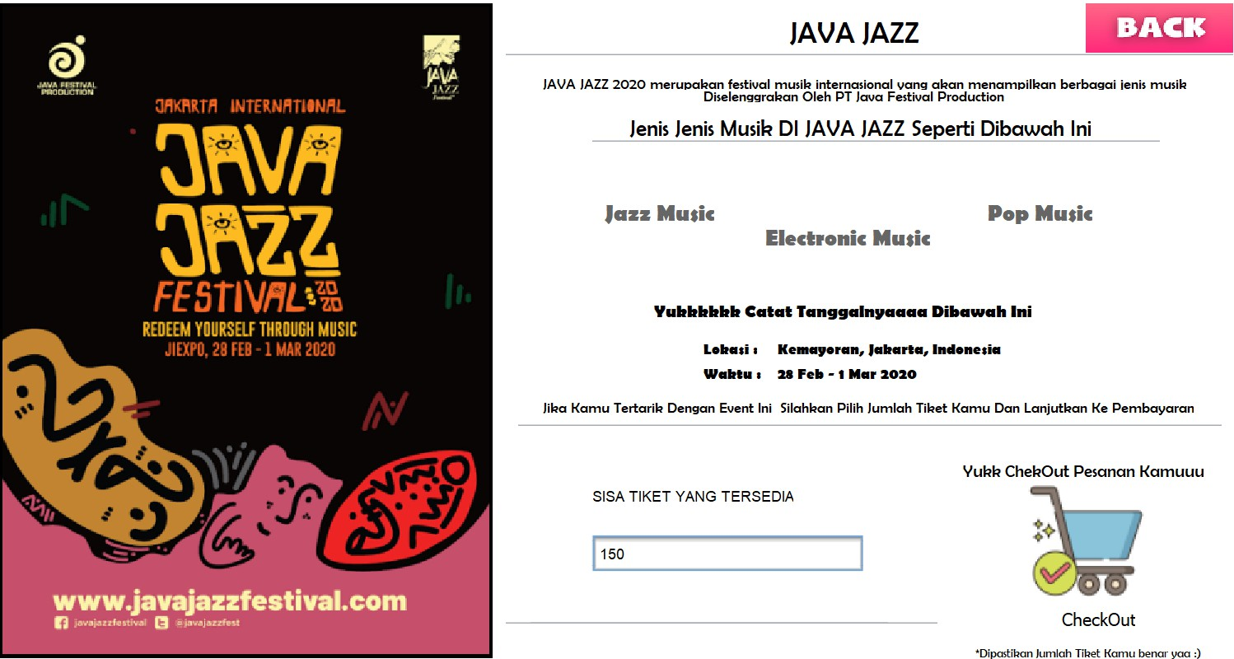
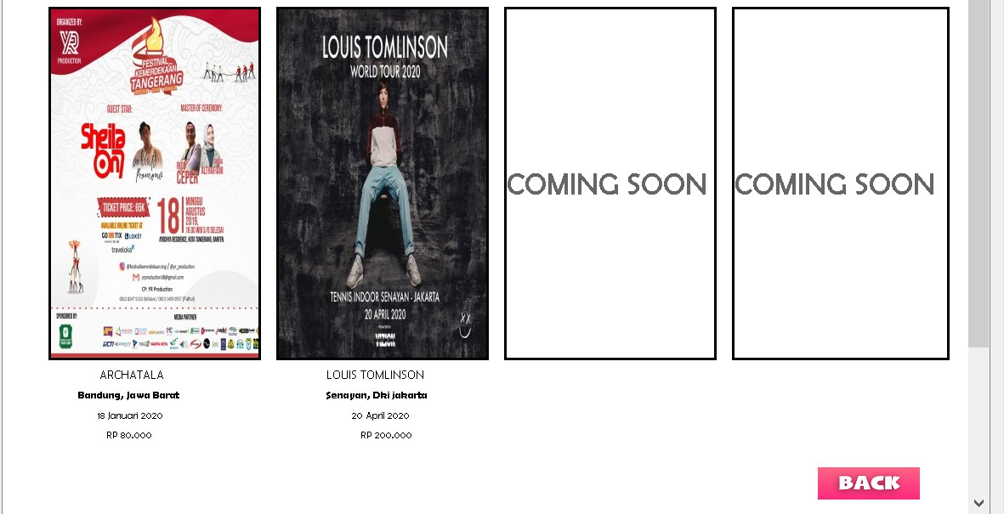
MENU KONSER
DETAIL KONSER

Slide 8
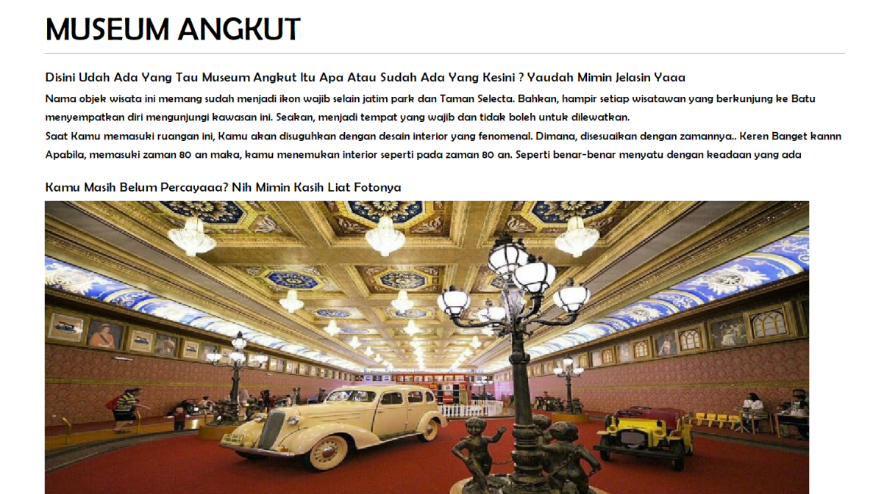
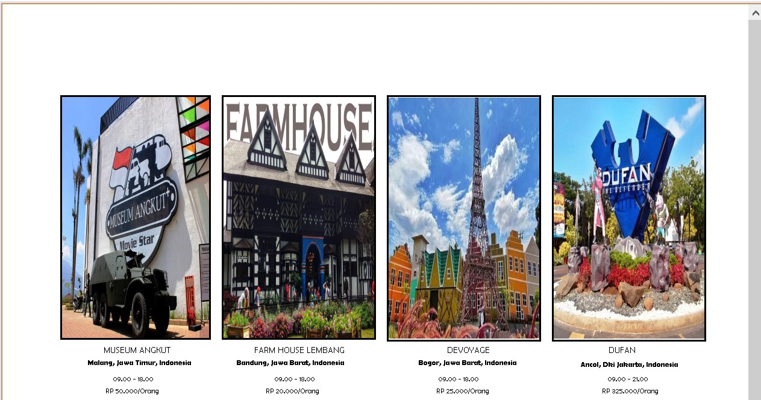
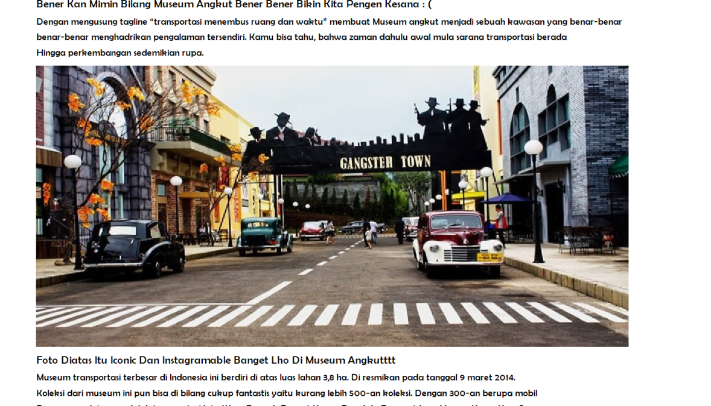
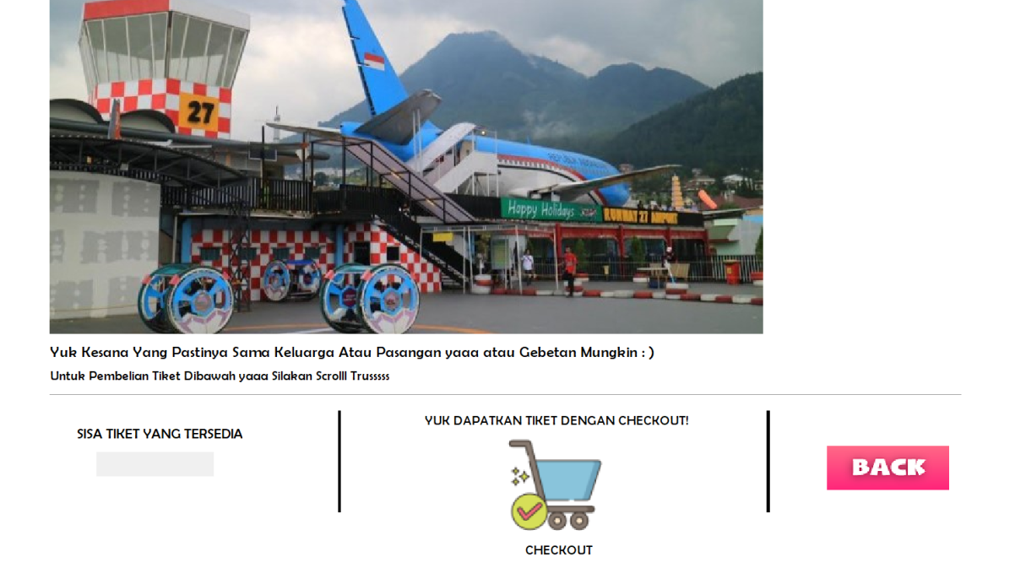
DETAIL WISATA
MENU WISATA

Slide 9
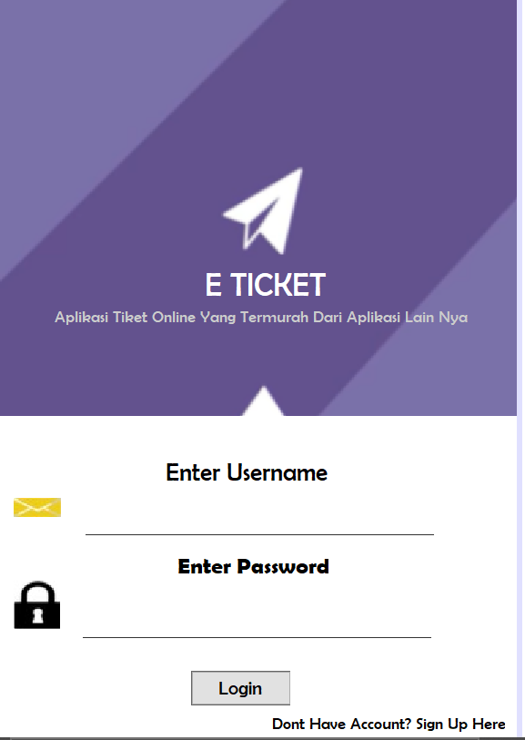
Historia
Form Logins
This Form is the page to login to application

Slide 10
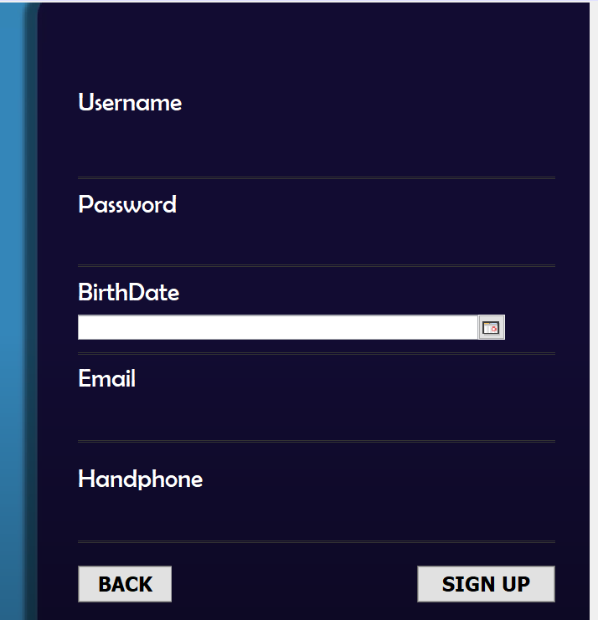
Form Register
This form used for register an account to be able to login

Slide 11
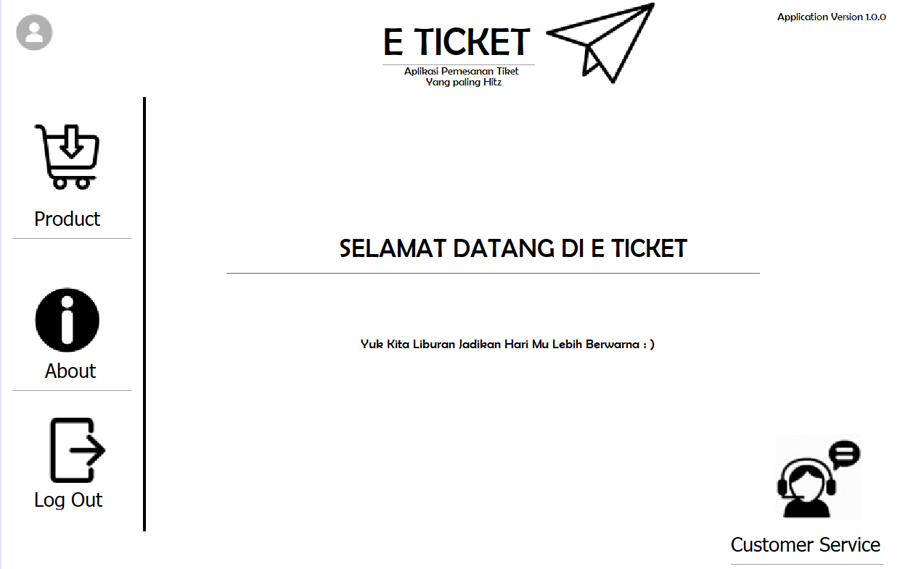
FORM WELCOME
There are 5 button that active :
Account
Customer Service
About
Product
Log Out

Slide 12
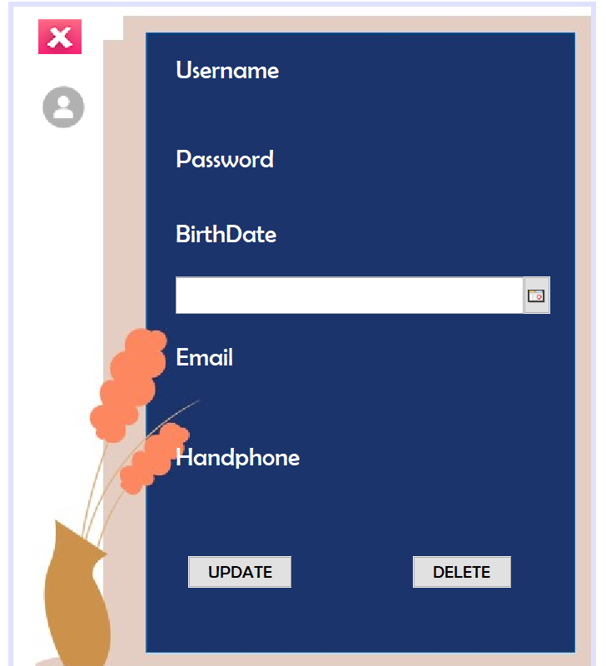
Form Account
This form is used to see, update and delete user info

Slide 13
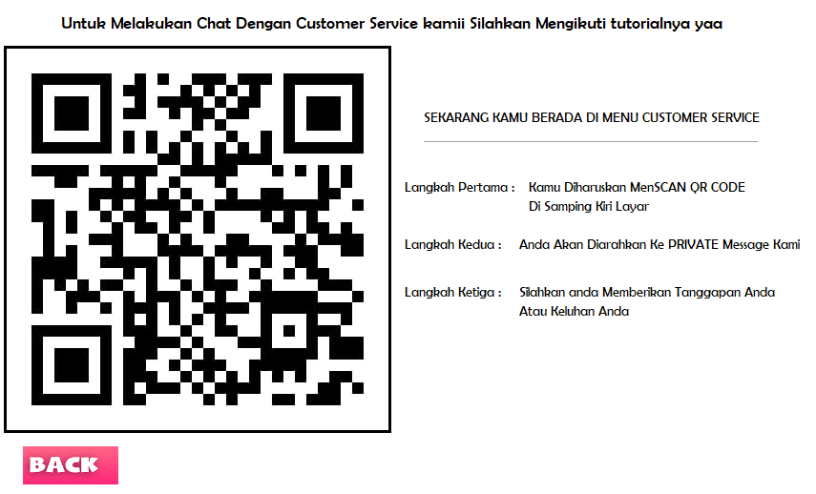
Form Customer
Service
This form is used if user has a question about this app. The barcode will go to programmer’s whatssapp

Slide 14
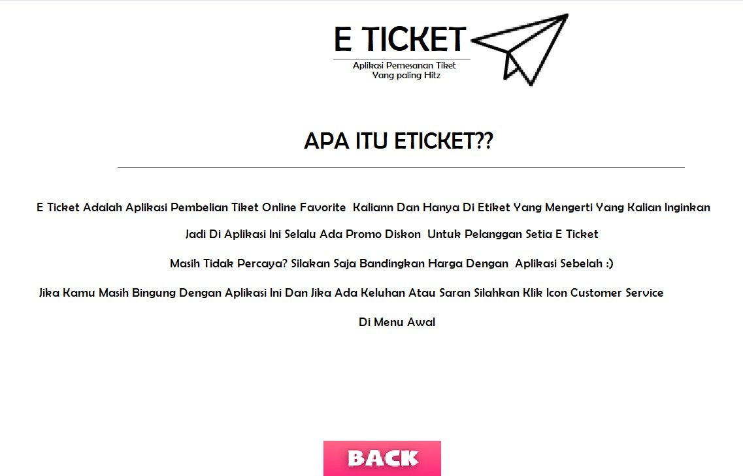
Form About
This form is used to explain a little about this application

Slide 15
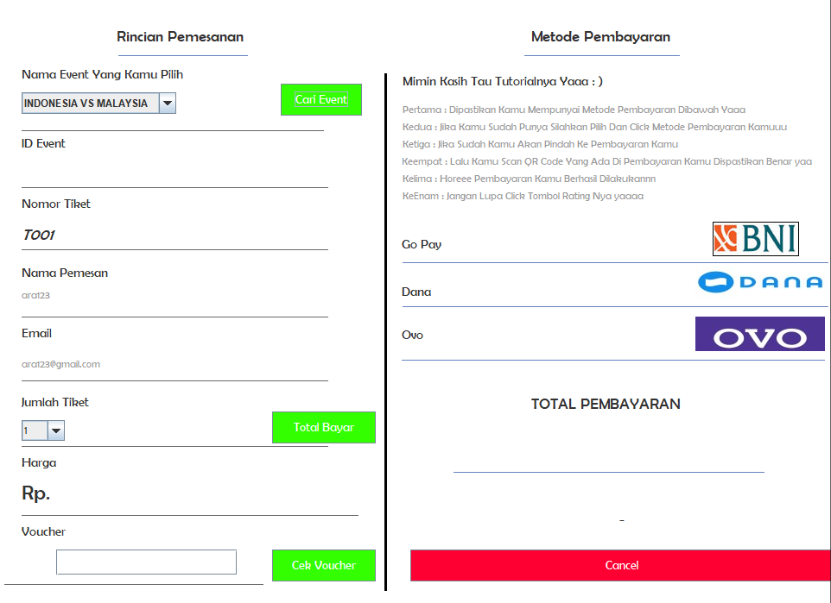
Payment Details
Payment Details
This form is to used when user want to make payment details

Slide 16
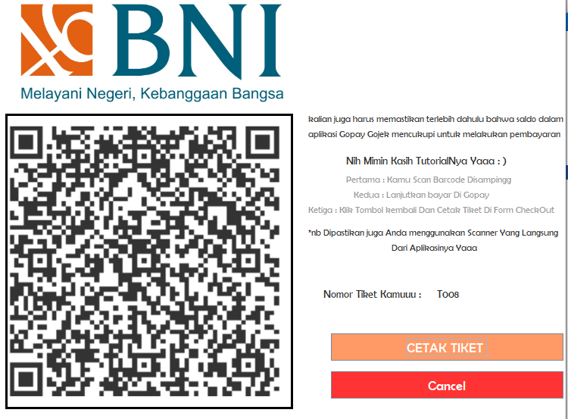
Payment
In this app have 3 method payment with bank, ovo, and dana.

Slide 17
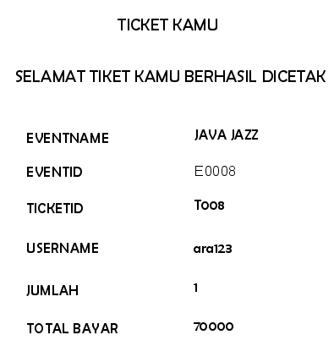
GET TICKET WITH JASPER REPORT

Slide 18
Thanks For Attention!

